Slide 1
Fusing global attention and self-attention for better performance and interpretability on tabular data
賴俊延
指導教授:郭炤裕老師、林逸芬老師
Bui, H., & Le, B. (2025). Expert Systems with Applications, 130220.

Slide 2
Outline
Background
Motivation
Methods

Slide 3
Background

Slide 4



Embedding
Background
E
X1
e11
e12
e13
e14
e15
E1
X2
e21
e22
e23
e24
e25
E2
X3
e31
e32
e33
e34
e35
E3
X4
e41
e42
e43
e44
e45
E4
X5
e51
e52
e53
e54
e55
E5

Slide 5
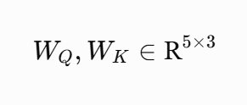
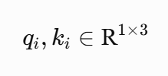


Query, Key & Value
Background
q1
q2
q3
E
Wq
Q
q4
q5
k1
k2
E
Wk
K
k3
k4
v1
k5
v2
E
Wv
V
v3
v4
v5

Slide 6
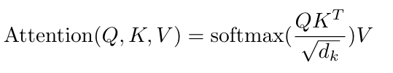
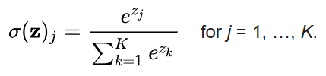
Attention (1)
Background
Vaswani, A., Shazeer, N., Parmar, N., Uszkoreit, J., Jones, L., Gomez, A. N., ... & Polosukhin, I. (2017). Attention is all you need. Advances in neural information processing systems, 30.
(Wikipedia)
q1
q1k1
q1k2
q1k3
q1k4
q1k5
q2
q2k1
q2k2
q2k3
q2k4
q2k5
q3
k1
k2
k3
k4
k5
q3k1
q3k2
q3k3
q3k4
q3k5
q4
q4k1
q4k2
q4k3
q4k4
q4k5
q5
q5k1
q5k2
q5k3
q5k4
q5k5

Slide 7
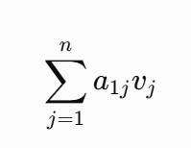
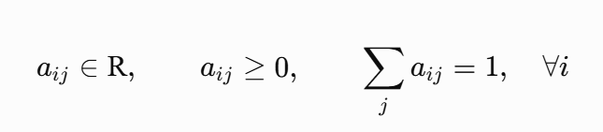
Attention (2)
Background
Vaswani, A., Shazeer, N., Parmar, N., Uszkoreit, J., Jones, L., Gomez, A. N., ... & Polosukhin, I. (2017). Attention is all you need. Advances in neural information processing systems, 30.
a11
a12
a13
a14
a15
v1
a21
a22
a23
a24
a25
v2
a31
a32
a33
a34
a35
v3
.
.
.
a41
a42
a43
a44
e45
v4
a51
a52
a53
a54
a55
v5

Slide 8
Concept
Background
I
Iike
you
WQ、WK
Attention
Wv

Slide 9
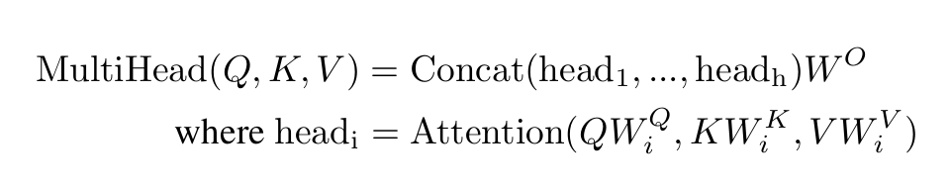
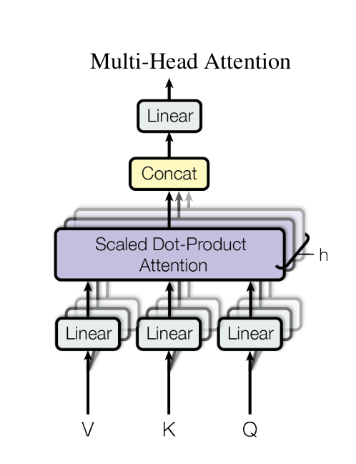
Muti-Head Attention
Background
Vaswani, A., Shazeer, N., Parmar, N., Uszkoreit, J., Jones, L., Gomez, A. N., ... & Polosukhin, I. (2017). Attention is all you need. Advances in neural information processing systems, 30.

Slide 10
Motivation

Slide 11

Why Deep Learning Struggles with Tabular Data
Motivation
Heterogeneous Feature Space
Composed of diverse data types (continuous, categorical, and ordinal) drawn from entirely different distributions.
No inherent spatial or sequential structure, unlike images or text.
Arbitrary Column Ordering
Column order carries no semantic meaning.
Models must be strictly permutation-equivariant to yield consistent outputs.
height | blood type | Pain intensity
170 | A | Mild
180 | B | moderate
155 | O | severe
160 | AB | severe
Image source : https://reurl.cc/5XRxpn

Slide 12
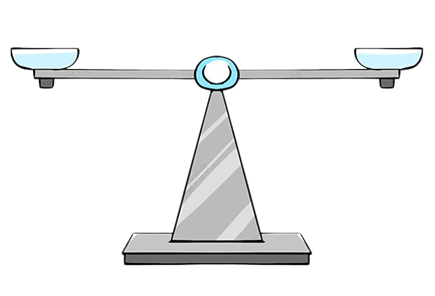
The Interpretability and Robustness Gap
Motivation
The "Black-Box" Adoption Barrier
Although deep learning matches tree-based SOTA models (e.g., GBDTs), real-world adoption is limited by a lack of transparency.
Current attention-based solutions often fail to balance model capacity with clear, dual-level explanations.
Modeling Complex Interactions Robustly
Existing models struggle to remain robust against uninformative features while learning irregular target functions.
Performance
Interpretability
Image source : Pngtree

Slide 13
Unifying Local and Global Perspectives
Motivation
Dual Structure of Tabular Patterns
Local Level: Instance-specific, fine-grained feature interactions unique to individual samples.
Global Level: Dataset-wide, population-level statistical dependencies consistent across all samples.
The Research Gap
Integrating multi-scale (local and global) attention in tabular learning remains underexplored.
Traditional methods process attention independently, missing cross-scale interactions.
Local
Global
Cross-Attention Fusion

Slide 14
Methods

Slide 15
Feature embedding block
Methods

